Slide 1
VEF Final Project Marketing Campaign
DA 2022.04 – TONG KHANH LINH

Slide 2
Table of contents
01
02
03
04
05
06
Objectives
Approaches
Overview
EDA & Feature Engineering
Results
Conclusions

Slide 3
01
Objectives

Slide 4
Objectives
Predict the customer who will accept an offer for a product or service based on the customer’s personal information, purchasing history and previous campaign response

Slide 5
02
Approaches

Slide 6
Approaches
Understand the context, the meaning of each variables
Define the objectives of the project
Find and solve the dataset potential problems through EDA and feature engineering
Choose suitable algorithms
Intepret the results and redo previous steps if needed

Slide 7
03
Overview

Slide 8
Dataset Overview
Data source
Context
From SAS Institute collected by Business Analytics Using SAS Enterprise Guide and SAS Enterprise Miner method.
Posted on Kaggle on March 2022
Data of customers’ personal information, purchases and previous – accepted campaign of a food and beverages Retail company

Slide 9
Dermographic Variables
Column | Data Type | Description
Year_Birth | int | Customers year of birth
Education | char | Customers level of education
Marital_Status | char | Customers marital status
Income | float | Customers yearly household income
KidHome, TeenHome | int | Number of small children and teenagers in customers household

Slide 10
Company-related Variables
Column | Data Type | Description
ID | int | Customers id
Dt_Customer | char | Date of customers’ enrolment with the company
Recency | int | Number of days since the last purchase
Complain | int | 1 if customer complained in the last 2 years
Z_CostContact | int | Cost to contact a customer
Z_Revenue | int | Revenue after client accepting campaign
Response | int | 1 if customer accepted the offer in the last campaign, 0 otherwise

Slide 11
Company-related Variables
Column | Data Type | Description
MntWines, MntFruits, MntMeatProducts, MntFishProducts, MntSweetProducts, MntGoldProds | int | Amount spent on Wines, Fruits, Meat, Fish, Sweet, Gold products in the last 2 years respectively
NumDealsPurchases, NumWebPurchases, NumCatalogPurchases, NumStorePurchases | int | Number of purchases made with discount, through companys web site, using catalogue, directly in stores
NumWebVisitsMonth | int | Number of visits to companys web site in the last month
AcceptedCmp1, AcceptedCmp2, AcceptedCmp3, AcceptedCmp4, AcceptedCmp5 | int | 1 if customer accepted the offer in the 1st, 2nd, 3rd,4th, 5th campaign, 0 otherwise

Slide 12
04
EDA& Feature Engineering

Slide 13
Summary
3 categorical variables: Dt_Custome, Marital_Status, Education
26 numerical variables
3 main problems: missing values, outliers and imbalanced data
Modeling:
StandardScaler()
Classification algorithms: Logistic Regression, Decision Tree

Slide 14
Categorical Variables
Dt_Customer
Max | 2014-06-29
Min | 2012-07-30
Education
Graduation | 1,127
PhD | 486
Master | 370
2n Cycle | 203
Basic | 54
Marital_Status
Married | 864
Together | 580
Single | 480
Divorced | 232
Widow | 77
Alone | 3
Absurd | 2
YOLO | 2

Slide 15
Categorical Variables
Dt_Customer
Max | 2014-07-30
Min | 2014-06-29
Guess that the data collected year could be 2014
Calculate customer’s age

Slide 16
Categorical Variables
Education
Graduation | 1,127
PhD | 486
Master | 370
2n Cycle | 203
Basic | 54
Turn into numerical variable based on the number of years for each education level:
Graduation: 12 years
PhD: 21 years
Master: 18 years
2n Cycle: 18 years
Basic: 5 years

Slide 17
Categorical Variables
Marital_Status
Married | 864
Together | 580
Single | 480
Divorced | 232
Widow | 77
Alone | 3
Absurd | 2
YOLO | 2
Alone, Absurd, YOLO: change to Single
One-hot-encoding

Slide 18
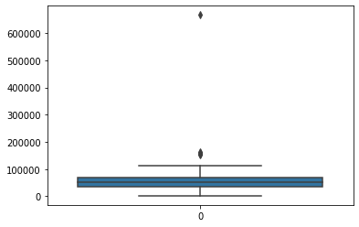
Outliers
Income has one extreme value: drop
Monetary and number of purchases variables does not have distinctively outliers: StandardScaler
Income Boxplot

Slide 19
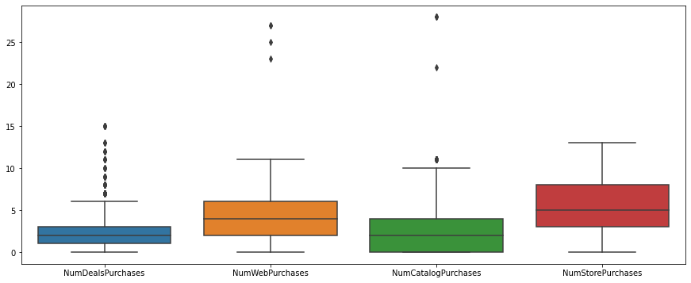
Outliers

Slide 20
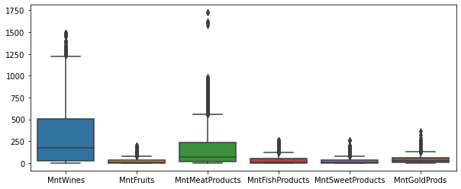
Outliers

Slide 21
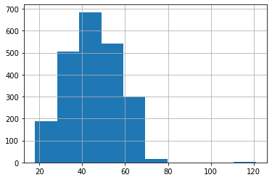
Outliers
age = 2014 – Year_Birth
3 value greater than 100 years old: drop
The rest range from 18 to 74 years old
Age Histogram

Slide 22
Imbalanced Data
Lablel | Count
0 | 1906
1 | 334
SMOTE
Class-weight

Slide 23
Missing Values
Income - missing rates: 1.07%
Create new varibles
Run Chi-test of Independence: Education, Marital_Status, child, age_range – Fill missing values
child: Kidhome + Teenhome
age_range: 18-24, 25-34, 35-44, 45-54, 55-64, and 65 and older

Slide 24
Grouping values
RFM Analysis
Recency
MonetaryValue: MntWines + MntFruits + MntMeatProducts + MntFishProducts + MntSweetProducts + MntGoldProds
Frequency = NumDealsPurchases + NumWebPurchases + NumCatalogPurchases + NumStorePurchases

Slide 25
05
Results

Slide 26
Results
2 classification algorithms on 2 dataframe
Correlation matrix: drop highly-correlated features
Drop Z_CostContact and Z_Revenue (only contains 1 value)
df_RFM_cmp: Dermographic variables, Recency, Frequency, Previous Campaign, Complain
df_full: Dermographic variables, Recency, Number of Purchases by categories, Monetary value by Categories, Previous Campaign, Complain

Slide 27
Results

Slide 28
Results Interpretation
Objective: predict which customer will accept the offer
Results:
Using balancing methods (class-weight and SMOTE): decrease the overall accuracy, increase the precision of label 1 prediction; but decrease label 0’s counterpart.
Accuracy: [0.73 – 0.85]
Precision:
0: [0.89 – 0.93]
1 : [0.34 – 0.64]

Slide 29
06
Conclusions

Slide 30
Conclusions
The overall score of label 0 score is acceptable, however label 1 precision score should be improved by:
Collecting more data
Selecting more suitable algorithms
Choosing different methods to balance data

Slide 31
Thanks for your attention!
Do you have any questions?

